Slide 1
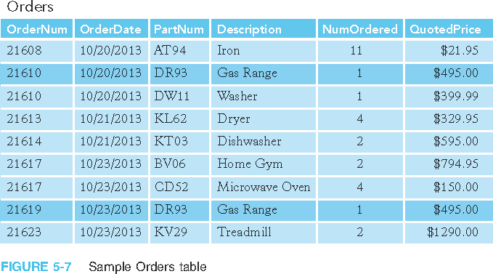
Second Normal Form
Sample Orders table in first normal form

Slide 2
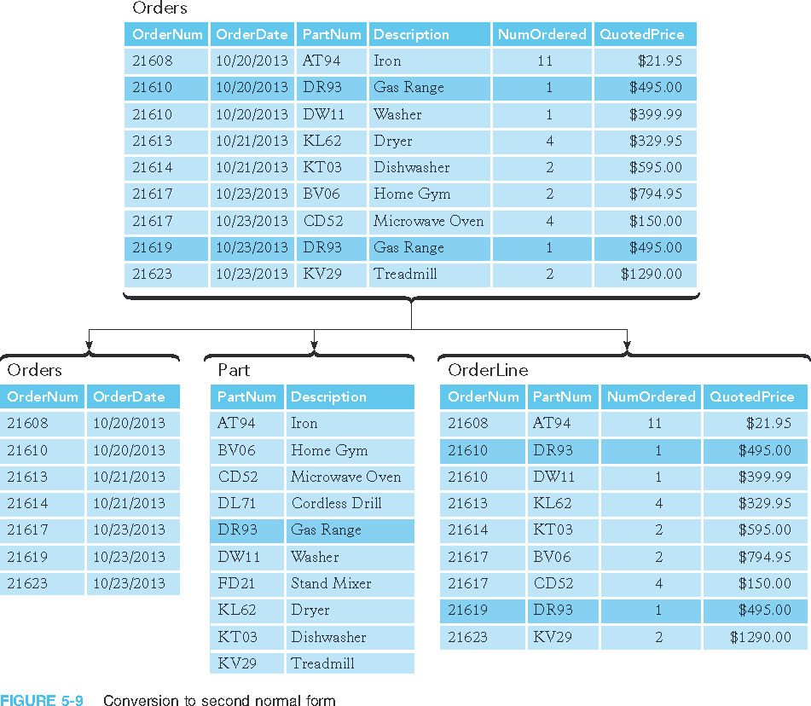
Second Normal Form (continued)
Conversion to second normal form

Slide 3
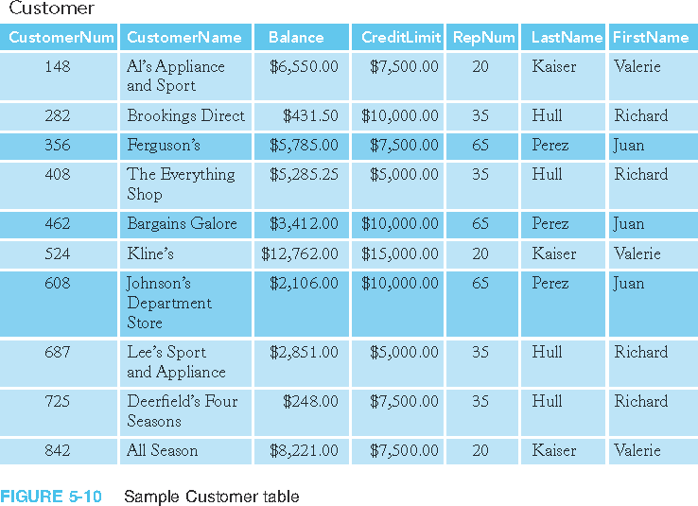
Third Normal Form (continued)
Sample Customer table

Slide 4
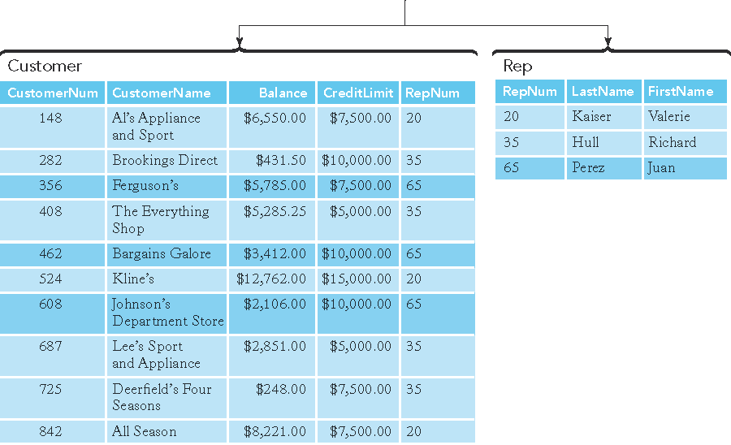
Third Normal Form (continued)
Conversion to third normal form

